Slide 1
Introduction
to
Microsoft word 2010

Slide 2
Formatting Pages in Word 2010

Slide 3
Objectives Overview
How to adjust page margins in word
How to insert header and footer in word
How to add page numbers in word
How to insert page breaks in word
How to insert blank page in word
How to add cover pages in word
How to add page orientation in word

Slide 4
Adjust Page Margins in Word 2010
Margins are the space between the edge of the paper and the text.
You can adjust the right, left, top, and bottom margins of your document.
By default, Word sets all margins left, right, top, and bottom to 1 inch.

Slide 5
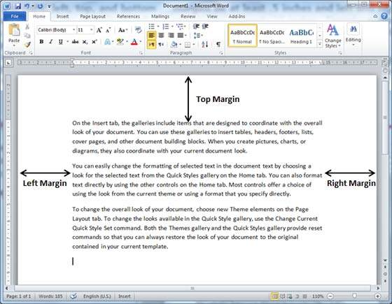
Adjust Page Margins in Word 2010
In the screenshot given below, I have shown top, left and right margins, if you will type the complete page, word will leave 1-inch bottom margin as well.

Slide 6
Adjust Margins
Step 1
Open the document the margins of which need to be set. If you want the margins to be applied only to a selected part of a document, select that particular part.
Step 2
Click the Page Layout tab, and click the Margins button in the Page Setup group.
This will display a list of options to be selected but you have to click the Custom Margins option available at the bottom.

Slide 7
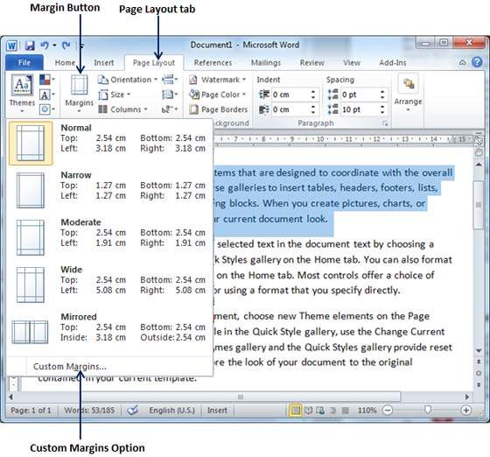
Adjust Margins

Slide 8
Adjust Margins
Step 3
You will have to display a Page Dialog Box as shown below where you can set top, left, right and bottom margins under the Margins Tab.
Select the Apply to: option to apply the margin on selected text or complete document.

Slide 9
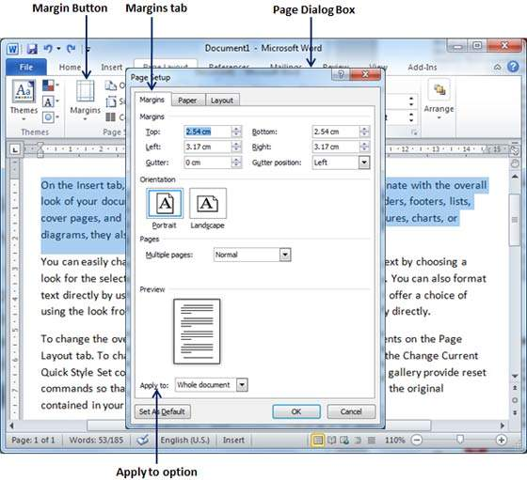
Adjust Margins

Slide 10
Adjust Margins
Step 4
If you are going to bind the document and want to add an extra amount of space on one edge for the binding, enter that amount in the Gutter text box.
select the side the gutter is on with the Gutter Position drop-down list. After setting all the desired values for all the margins, click the OK button to apply the margins.

Slide 11
Header and Footer in Word 2010
Headers and footers are parts of a document that contain special information such as page numbers and the total number of pages, the document title, company logo, any photo, etc.
The header appears at the top of every page, and the footer appears at the bottom of every page.

Slide 12
Add Header and Footer
Step 1
Click the Insert tab, and click either the Header button or the Footer button that which needs to be added first.
Assume you are going to add Header; when you click the Header button it will display a list of built-in Headers from where you can choose any of the headers by simply clicking on it.

Slide 13
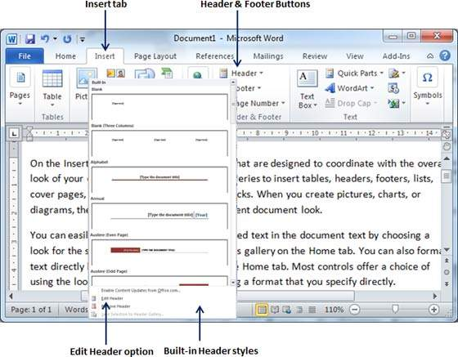
Add Header and Footer

Slide 14
Add Header and Footer
Step 2
Once you select any of the headers, it will be applied to the document in editable mode and the text in your document will appear dimmed,
Header and Footer buttons appear on the Ribbon and a Close Header and Footer button will also appear at the top-right corner.

Slide 15
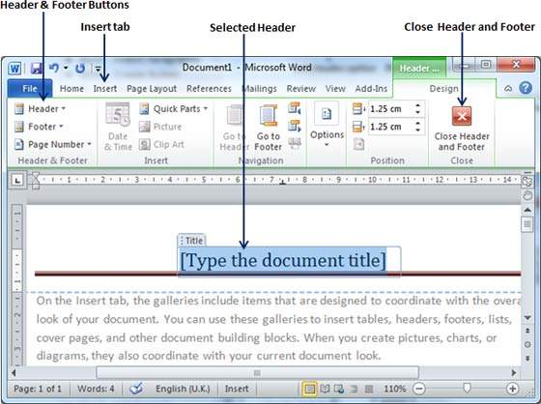
Add Header and Footer

Slide 16
Add Header and Footer
Step 3
Finally, you can type your information whatever you want to have in your document header.
Once you are done, click Close Header and Footer to come out of the header insertion mode.

Slide 17
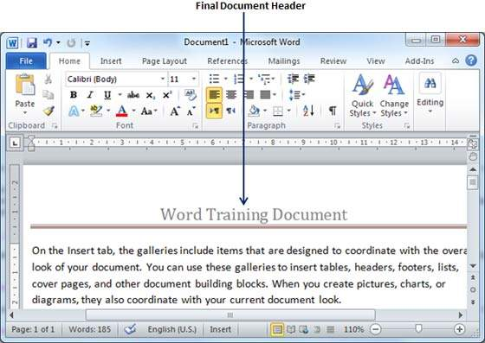
Add Header and Footer
You can follow a similar procedure to add footer in your document.

Slide 18
Edit Header and Footer
Step 1
Click the Insert tab
click either the Header button or Footer button or whatever you want to edit.
Assume you are going to edit the Header, so when you click the Header button it will display a list of options including the Edit Header option.

Slide 19
Edit Header and Footer

Slide 20
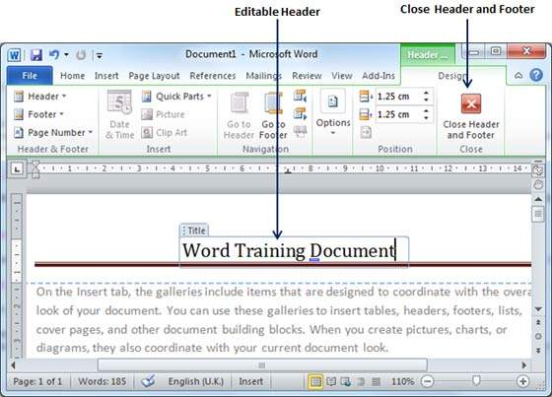
Edit Header and Footer
Step 2
Click on the Edit Header option and Word will display the editable header as shown in the following screenshot.
Step 3
Now you can edit your document header and once you are done, click Close Header and Footer to come out of the edit header mode.

Slide 21
Add Page Numbers in Word 2010
Microsoft Word automatically assigns page numbers on the pages of your document.
Typically, page numbers are printed either in header or footer but you have the option that can display the page number in the left or right margins at the top or the bottom of a page.

Slide 22
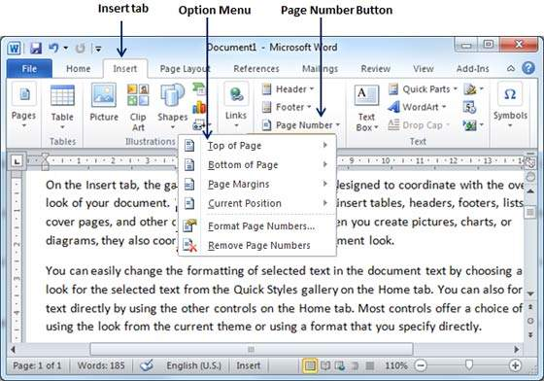
Add Page Numbers
Step 1
Click the Insert tab, and click the Page Number button available in the header and footer section.
This will display a list of options to display the page number at the top, bottom, current position etc.

Slide 23
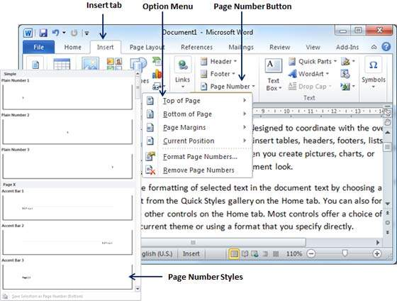
Add Page Numbers
Step 2
When you move your mouse pointer over the available options, it displays further styles of page numbers to be displayed.
For example, when I take the mouse pointer at the Bottom of Page option it displays the following list of styles.

Slide 24
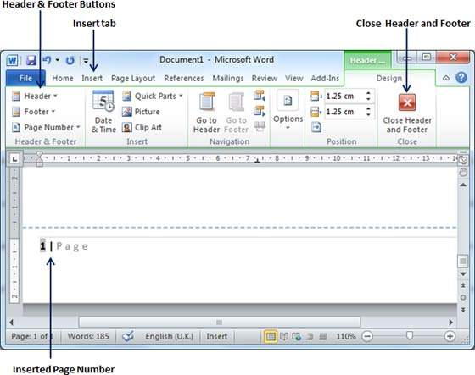
Add Page Numbers
Step 3
Finally, select any one of the page number styles. I selected the Accent Bar 1 style by clicking over it.
You will be directed to the Page Footer modification mode. Click the Close Header and Footer button to come out of the Footer Edit mode.

Slide 25
Remove Page Numbers
Step 1
Click the Insert tab, and
Click the Page Number button available in the header and footer section.
This will display a list of options to display page number at the top, bottom, current position, etc.
At the bottom, you will have the Remove Page Numbers option. Just click this option and it will delete all the page numbers set in your document.

Slide 26
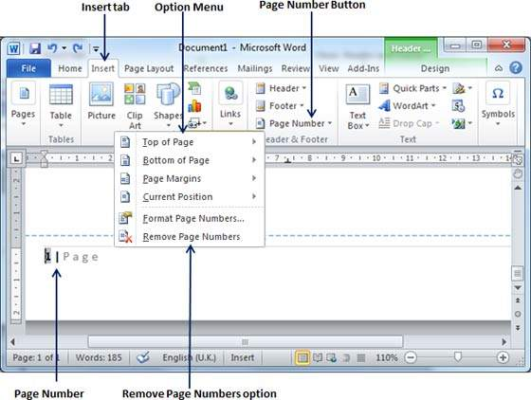
Remove Page Numbers
Step 1

Slide 27
Insert Page Breaks in Word 2010
Microsoft Word automatically starts a new page when the current page fills with text but you can insert a page break to force Word to start text on a new page.
You can insert a page break using either the mouse or the keyboard.

Slide 28
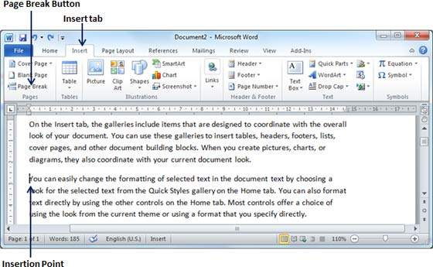
Insert Page Breaks
Step 1
Bring your insertion point immediately before the text that has to appear on a new page.
Step 2
Click the Insert tab, and click the Page Break button available in the Pages group.

Slide 29
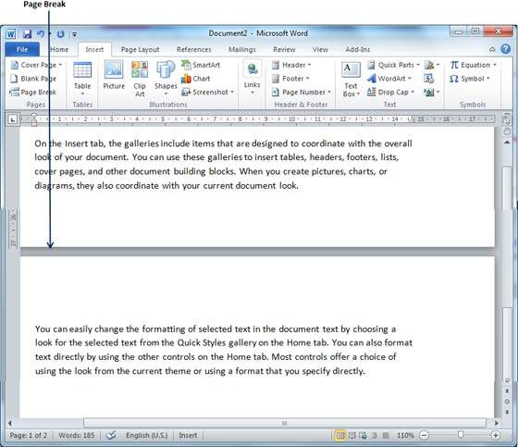
Insert Page Breaks
Step 2
Word inserts a page break and moves all text after the page break onto a new page.
You can also use the Ctrl + Enter keys to create a page break at the pointed location.

Slide 30
Delete a Page Break
Just put the insertion point on the previous page of the page break that needs to be deleted.
Press the Delete key multiple times until both the pages get merged.

Slide 31
Insert Blank Pages in Word 2010
A blank page is a page which does not have any text or any other content over it.

Slide 32

Insert Blank Pages
Step 1
Bring your insertion point immediately before the text where you want to insert a blank page.
Step 2
Click the Insert tab, and click the Blank Page button available in the Pages group.

Slide 33
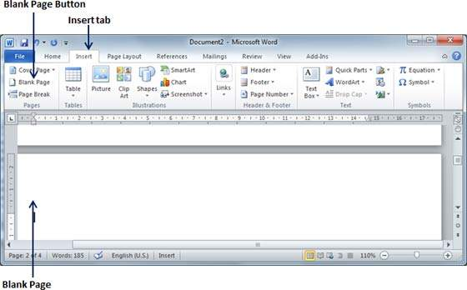
Insert Blank Pages
Step 2
Word inserts a new blank page and moves all the text after the page break onto a new page.

Slide 34
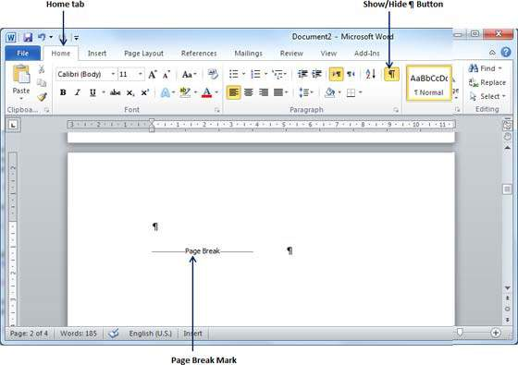
Delete Blank Pages
Step 1
Click the Home tab
Click the Show/Hide ¶ paragraph marks button available in the Paragraph group or simply press the Ctrl + Shift + * keys. This will display all the page breaks as shown below.

Slide 35
Delete Blank Pages
Step 2
Bring your cursor immediately before the Page Break mark available on the blank page and press the Delete Key.
This will delete the blank page and again you can click the Show/Hide ¶ paragraph marks button to hide all the paragraph marks.

Slide 36
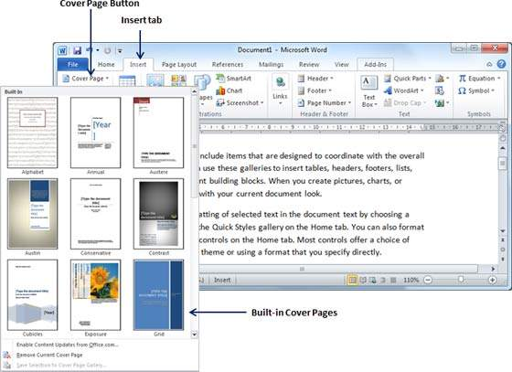
Add Cover Pages in Word 2010
Step 1
Click the Insert tab.
Click the Cover Page button available in the Pages group. This will display a list of Built-in Cover Pages as shown below.

Slide 37
Add Cover Pages in Word 2010
Step 2
Choose a cover page from the options available in the gallery.
The selected cover page will be added as the first page of your document which can later be modified according to the requirements.
If you want to place the cover page elsewhere except the first page,
Right-click the cover page in the gallery and select the location you want from the menu that appears.

Slide 38
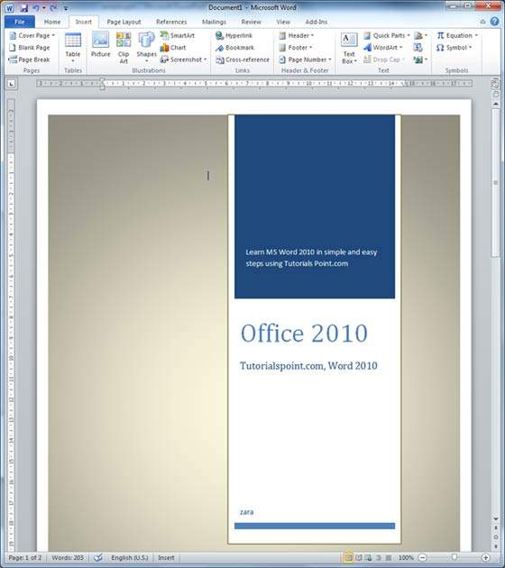
Add Cover Pages in Word 2010
Step 2

Slide 39
Delete Cover Pages
Step 1
Click the Insert tab.
Click the Cover Page button available in the Pages group.
This will display a list of Built-in Cover Pages as shown below.
You will find a Remove Current Cover Page option available at the bottom of the cover page gallery.

Slide 40

Delete Cover Pages
Step 1

Slide 41
Delete Cover Pages
Step 2
Click the Remove Current Cover Page option and your cover page will be deleted from your document.

Slide 42
Page Orientation in Word 2010
Page Orientation is useful when you print your pages.
By default, Microsoft Word shows a page in portrait orientation and in this case the width of the page is less than the height of the page; the page will be 8.5 inches × 11 inches.
You can change the page orientation from portrait to landscape orientation.

Slide 43
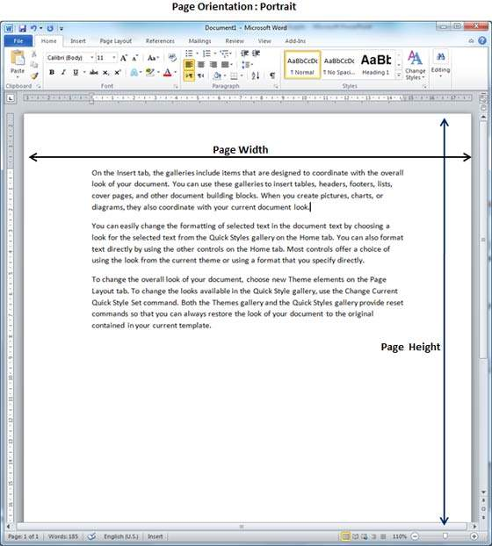
Change Page Orientation
Step 1
Open the Word document the orientation of which needs to be changed.
By default, orientation will be Portrait Orientation as shown below.

Slide 44
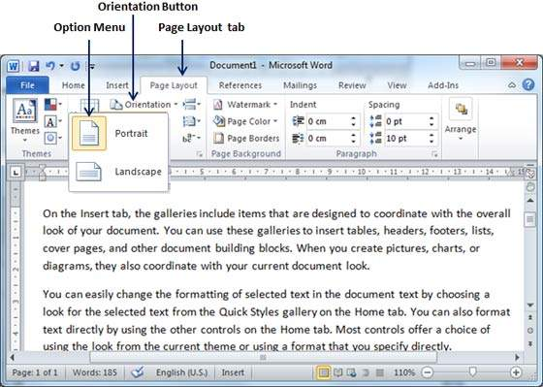
Change Page Orientation
Step 2
Click the Page Layout tab, and click the Orientation button available in the Page Setup group.
This will display an Option Menu having both the options (Portrait & Landscape) to be selected.

Slide 45
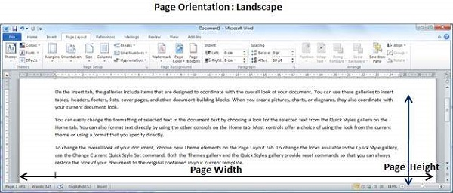
Change Page Orientation
Step 3
Click any of the options you want to set to orientation. Because our page is already in portrait orientation,
we will click the Landscape option to change my orientation to landscape orientation.

Slide 46


Slide 47
THANK YOU

